Slide 1
ReactJS Introduction
Mendel Rosenblum

Slide 2
ReactJS
https://mn.reactjs.org/
JavaScript framework for writing the web applications
  Like AngularJS - Snappy response from running in browser
  Less opinionated: only specifies rendering view and handling user interactions
Uses Model-View-Controller pattern
  View constructed from Components using pattern
  Optional, but commonly used HTML templating
Minimal server-side support dictated
Focus on supporting for programming in the large and single page applications
  Modules, reusable components, testing, etc.

Slide 3
ReactJS Web Application Page
<!doctype html>
<html>
<head>
<title>CS142 Example</title>
</head>
<body>
<div id="reactapp"></div>
<script src="./webpackOutput/reactApp.bundle.js"></script>
</body>
</html>
ReactJS applications come as a JavaScript blob that will use the DOM interface to write the view into the div.

Slide 4
ReactJS tool chain
React.js
React Components
Component #1
Webpack
Babel
Component #2
Output Bundle.js
Babel
...
Component #N
Babel
Babel - Transpile language features (e.g. ECMAScript, JSX) to basic JavaScript
Webpack - Bundle modules and resources (CSS, images) Output loadable with single script tag in any browser

Slide 5
reactApp.js - Render element into browser DOM
ES6 Modules - Bring in React and web app React components.
import React from 'react';
import ReactDOM from 'react-dom';
import ReactAppView from './components/ReactAppView';
let viewTree = React.createElement(ReactAppView, null); let where = document.getElementById('reactapp');
ReactDOM.render(viewTree, where);
Renders the tree of React elements (single component named ReactAppView) into the browser's DOM at the div with id=reactapp.

Slide 6
components/ReactAppView.js - ES6 class definition
import React from 'react';
class ReactAppView extends React.Component {
constructor(props) { super(props);
...
}
render() { ...
Inherits from React.Component. props is
set to the attributes passed to the component.
Require method render() - returns React element tree of the Component's view.
};
export default ReactAppView;

Slide 7

ReactAppView render() method
<div>
<label>Name: </label>
<input type="text" … />
<h1>Hello {this.state.yourName}!</h1>
</div>
render() {
let label = React.createElement('label', null,'Name: '); let input = React.createElement('input',
{ type: 'text', value: this.state.yourName, onChange: (event) => this.handleChange(event) });
let h1 = React.createElement('h1', null,
'Hello ', this.state.yourName, '!');
return React.createElement('div', null, label, input, h1);
}
Returns element tree with div (label, input, and h1) elements

Slide 8
ReactAppView render() method w/o variables
render() {
return React.createElement('div', null, React.createElement('label', null,'Name: '), React.createElement('input',
{ type: 'text', value: this.state.yourName, onChange: (event) => this.handleChange(event) }),
React.createElement('h1', null,
'Hello ', this.state.yourName, '!')
);
}

Slide 9
Use JSX to generate calls to createElement
render() {
return (
<div>
<label>Name: </label>
<input
type="text" value={this.state.yourName} onChange={this.handleChange}
/>
<h1>Hello {this.state.yourName}!</h1>
</div>
);

Slide 10
Component state and input handling
import React from 'react';
class ReactAppView extends React.Component {
constructor(props) { super(props);
this.state = {yourName: ""};
}
handleChange = (event) => {
Make <h1>Hello {this.state.yourName}!</h1>
work
this.setState({ yourName: event.target.value });
}
....
Input calls to setState which causes React to call render() again

Slide 11

One way binding: Type 'D' Character in input box
JSX statement: <input type="text" value={this.state.yourName} onChange={(event) => this.handleChange(event)} />
Triggers handleChange call with event.target.value == "D"
handleChange - this.setState({yourName: event.target.value});
this.state.yourName is changed to "D"
React sees state change and calls render again:
Feature of React - highly efficient re-rendering

Slide 12
Calling React Components from events: A problem
class ReactAppView extends React.Component {
...
handleChange(event) {
this.setState({ yourName: event.target.value });
}
...
}
Understand why:
<input type="text" value={this.state.yourName} onChange={this.handleChange} />
Doesn't work!
Notes:
Error line: this.setState({yourName: event.target.value});
TypeError: Cannot read property 'setState' of undefined
arrow functions use lexical scoping

Slide 13
Calling React Components from events workaround
Create instance function bound to instance
class ReactAppView extends React.Component { constructor(props) {
super(props);
this.state = {yourName: ""};
this.handleChange = this.handleChange.bind(this);
}
handleChange(event) {
this.setState({ yourName: event.target.value });
}

Slide 14
Calling React Components from events workaround
Using public fields of classes with arrow functions
class ReactAppView extends React.Component { constructor(props) {
super(props);
this.state = {yourName: ""};
}
handleChange = (event) => {
this.setState({ yourName: event.target.value });
}
...

Slide 15
Calling React Components from events workaround
Using arrow functions in JSX
class ReactAppView extends React.Component {
…
handleChange(event) {
this.setState({ yourName: event.target.value });
}
render() { return (
<input type="text" value={this.state.yourName} onChange={(event) => this.handleChange(event)} />
);
}

Slide 16
A digression: camelCase vs dash-case
Word separator in multiword variable name
Use dashes: active-buffer-entry
Capitalize first letter of each word: activeBufferEntry
Issue: HTML is case-insensitive but JavaScript is not.
ReactJS's JSX has HTML-like stuff embedded in JavaScript.
ReactJS: Use camelCase for attributes
AngularJS: Used both: dashes in HTML and camelCase in JavaScript!
Notes:
onchange must be onChange in ReactJS!

Slide 17
Programming with JSX
Need to remember: JSX maps to calls to React.createElement
  Writing in JavaScript HTML-like syntax that is converted to JavaScript function calls
React.createElement(type, props, ...children);
type: HTML tag (e.g. h1, p) or React.Component
props: attributes (e.g. type="text") Uses camelCase!
children: Zero or more children which can be either:
String or numbers
A React element
An Array of the above

Slide 18
JSX templates must return a valid children param
Templates can have JavaScript scope variables and expressions
  <div>{foo}</div>
    Valid if foo is in scope (i.e. if foo would have been a valid function call parameter)
  <div>{foo + 'S' + computeEndingString()}</div>
    Valid if foo & computeEndString in scope
Template must evaluate to a value
  <div>{if (useSpanish) { … } }</div> - Doesn't work: if isn't an expression
  Same problem with "for loops" and other JavaScript statements that don't return values
Leads to contorted looking JSX: Example: Anonymous immediate functions
  <div>{ (function() { if …; for ..; return val;})() }</div>
Notes:
Variable or Expression → returns a value ← must evaluate a value

Slide 19
Conditional render in JSX
Use JavaScript Ternary operator (?:)
<div>{this.state.useSpanish ? <b>Hola</b> : "Hello"}</div>
Use JavaScript variables
let greeting;
const en = "Hello"; const sp = <b>Hola</b>; let useSpanish = this.prop;
if (useSpanish) {greeting = sp} else {greeting = en};
<div>{greeting}</div>

Slide 20
Iteration in JSX
Use JavaScript array variables
let listItems = [];
for (let i = 0; i < data.length; i++) {
listItems.push(<li key={data[i]}>Data Value {data[i]}</li>);
}
return <ul>{listItems}</ul>;
Functional programming
<ul>{data.map((d) => <li key={d}>Data Value {d}</li>)}</ul>
key= attribute improves efficiency of rendering on data change

Slide 21
Styling with React/JSX
Webpack can import CSS style sheets:
.cs142-code-name {
font-family: Courier New, monospace;
}
import React from 'react'; import './ReactAppView.css';
class ReactAppView extends React.Component {
…
render() {
return (
<span className="cs142-code-name">
...
</span>
Must use className= for HTML class= attribute (JS keyword conflict)
);

Slide 22
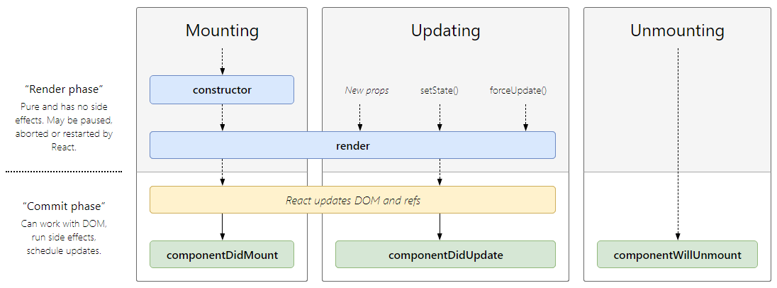
Component lifecycle and methods
http://projects.wojtekmaj.pl/react-lifecycle-methods-diagram/

Slide 23
Example of lifecycle methods
class Example extends React.Component {
...
componentDidMount() { // Start 2 sec counter const incFunc =
() => this.setState({ counter: this.state.counter + 1 }); this.timerID = setInterval(incFunc, 2 * 1000);
}
componentWillUnmount() { // Shutdown timer clearInterval(this.timerID);
}
...
Notes:
an example of timer
→ need to be updated in schedule
→ run side effects immediately
// To demonstate state updating we define a function
// that increments the counter state and instruct the
// DOM to call it every 2 seconds.
// componentDidMount - Called when Component is activiated
componentDidMount()
// We need to tell the DOM to stop calling us otherwise React
// will complain when we call setState on an unmounted component.
// componentWillUnmount - Called when Component is deactivated.
componentWillUnmount()

Slide 24
Stateless Components
React Component can be function (not a class) if it only depends on props
function MyComponent(props) {
return <div>My name is {props.name}</div>;
}
Or using destructuring...
function MyComponent({name}) {
return <div>My name is {name}</div>;
}
Use:
<MyComponent name='Function Component! via JSX'/>

Slide 25
Communicating between React components
Passing information from parent to child: Use props (attributes)
<ChildComponent param={infoForChildComponent> />
Passing information from child to parent: Callbacks
this.parentCallback = (infoFromChild) =>
{ /* processInfoFromChild */};
<ChildComponent callback={this.parentCallback}> />
React Context (https://reactjs.org/docs/context.html)
  Global variables for subtree of components
Notes:
data is passed top-down (parent to child) via props
Context shares values like locale, UI theme etc. between components

